Slide 1
Job Recommendation System: Based on NLP Techniques
Chen Taijie (ctj21@connect.hku.hk)
Tan Wenting (wt212796@connect.hku.hk)
Wang Jiayi (u3590646@connect.hku.hk)
Zhang Yuhao (yuhao101@connect.hku.hk)
8th, Jun, 2022

Slide 2
Background
More and more firms recruit their employees through online job posting platforms such as 51job.com and zhaopin.com.
The large quantity of online job postings provides timely and valuable labor demand information.
To explore the potential economic value of the rich online job posting information, a key step is the standardization of the textual information posted by millions of diverse employers.
2

Slide 3
Webpage
Webpage
3

Slide 4

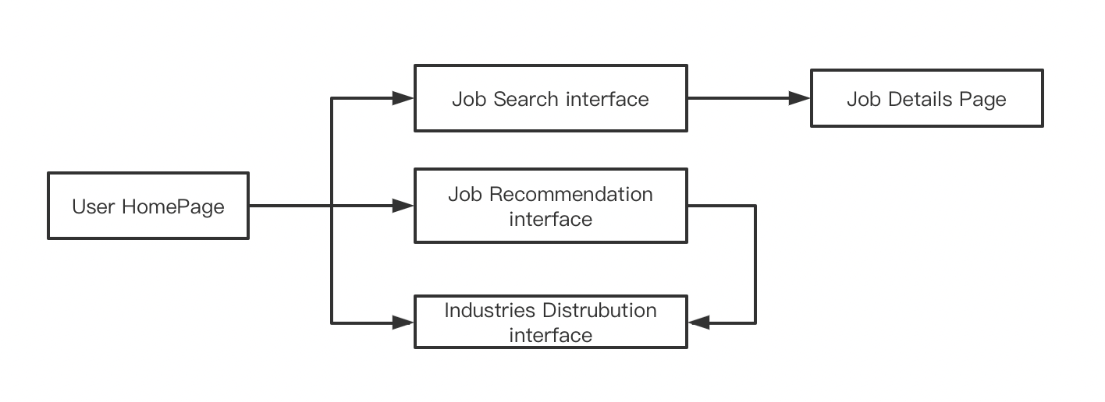
System Design — Front-end
UI Framework
6

Slide 5

Front-end Design
Homepage Design
Top bar: NavMenu provides navigation functions for the website. We can switch to different pages here.
Name of Project
Objective of Project
6

Slide 6
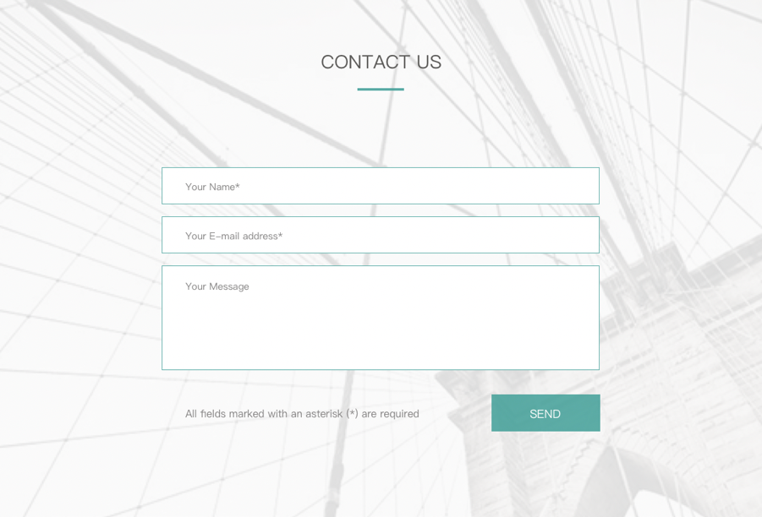
Front-end Design
Homepage Design
Input boxes: Controlled component for user to input their personal information and message they would like to send, which always displays Vue binding values
Iconbutton: receive click event to send the input content to backend as identified data sheet.
6

Slide 7
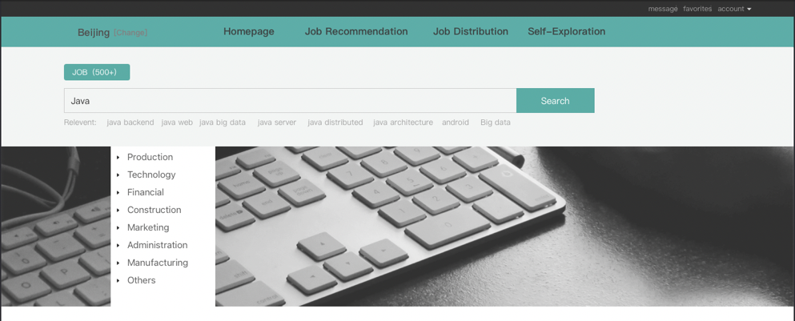
Front-end Design
Job Search Interface
Top bar: NavMenu provides navigation functions for the website. Help us to switch to different pages.
Search bar
Tree: Presents industries in a clear hierarchy that can be expanded or collapsed.
6

Slide 8
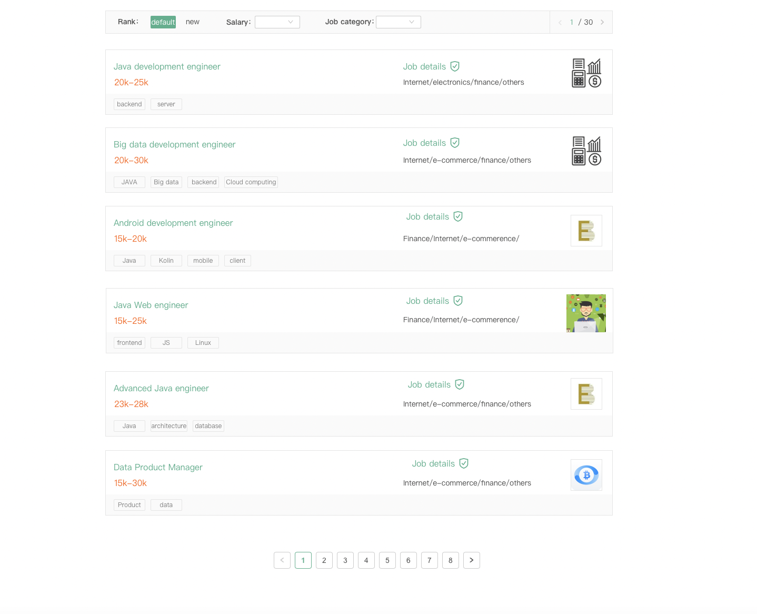
Front-end Design
Job Search Interface
Description list: multiple fields are displayed in a list, here is about the specific job
Text link: ”job details” as text link that link to Job Details webpage
Pagination: You can see more jobs by selecting pages.
6

Slide 9
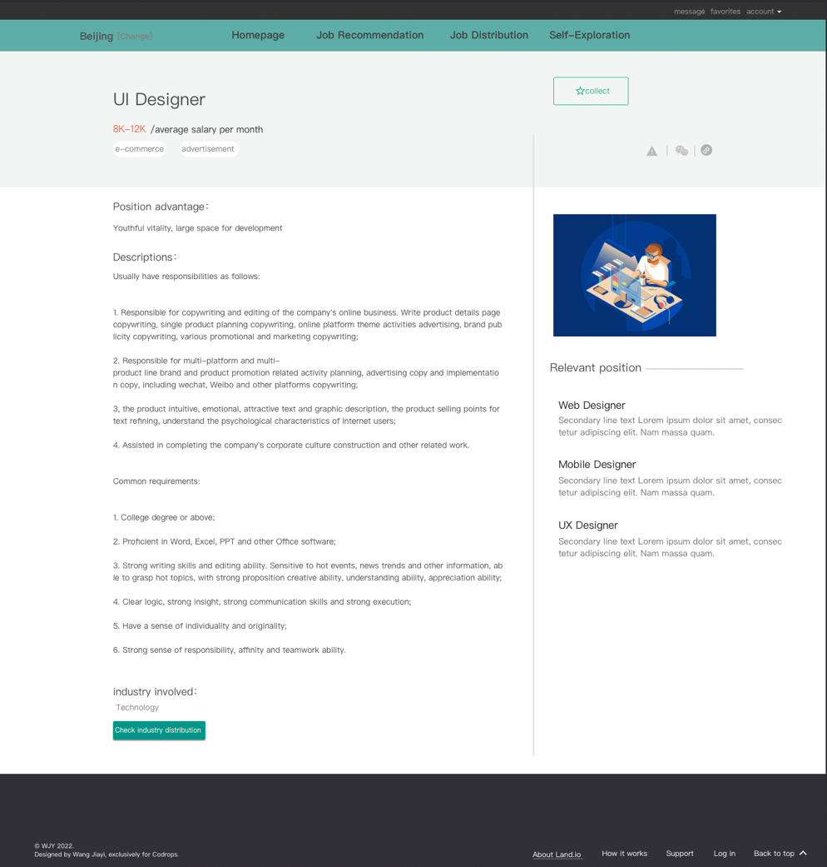
Front-end Design
Job Detail Interface
Button: work for collection, record the users interesting careers.
The other work for user to check the corresponding industry distribution of this job.
6

Slide 10
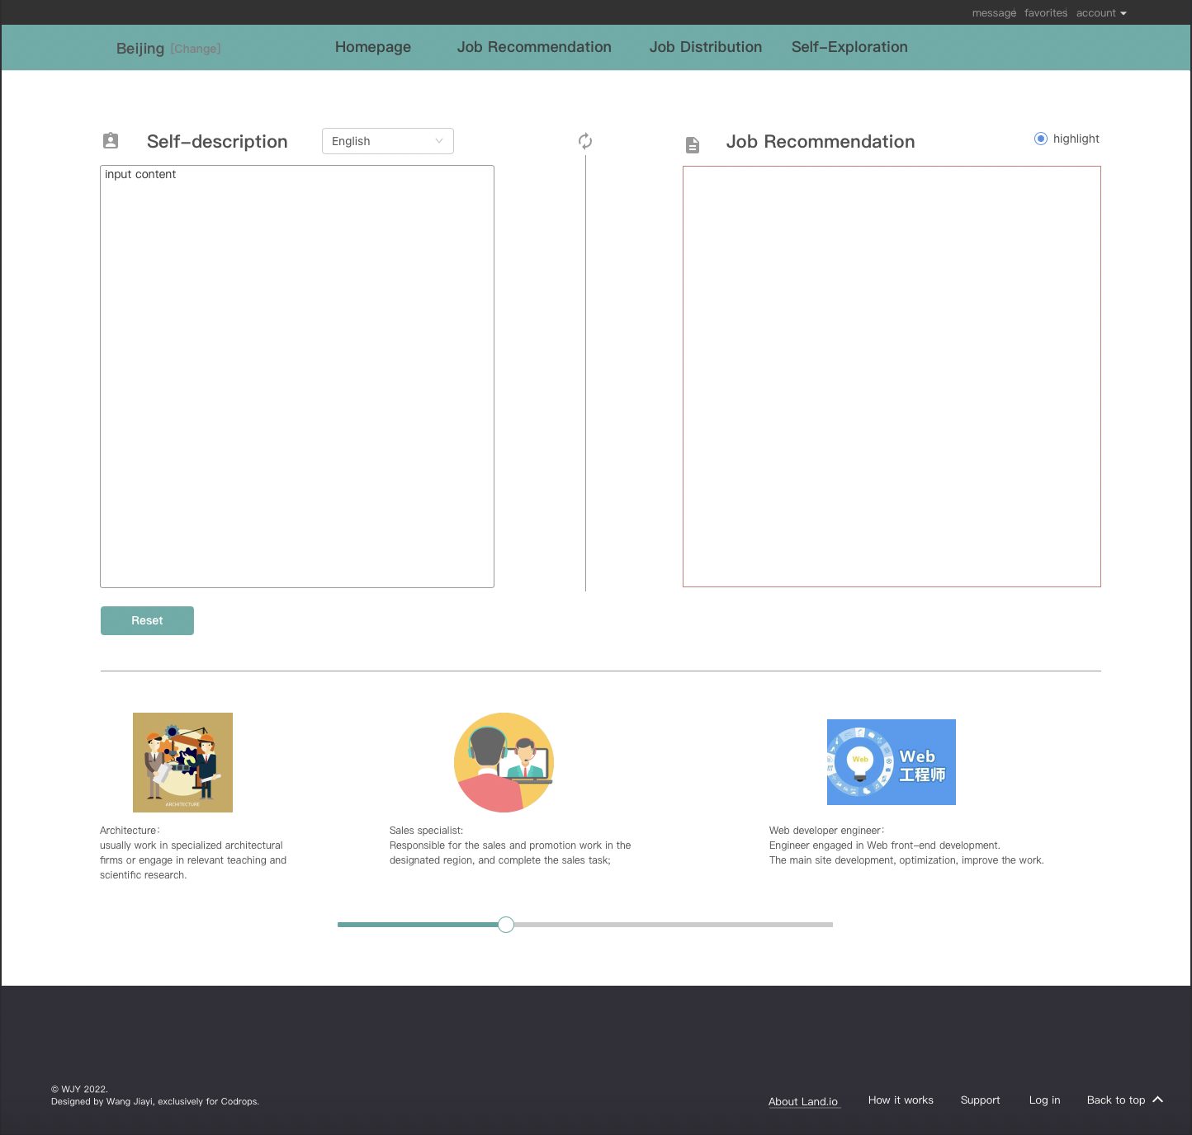
Front-end Design
Job Recommendation Interface
Selector: choosing language you prefer to input.
Corresponding recommendation template created by our model is shown here
Text field: the left box, used to input multi-line text information by specifying the value of the type attribute as textarea.
Can also choose career directly here to check its description
6

Slide 11
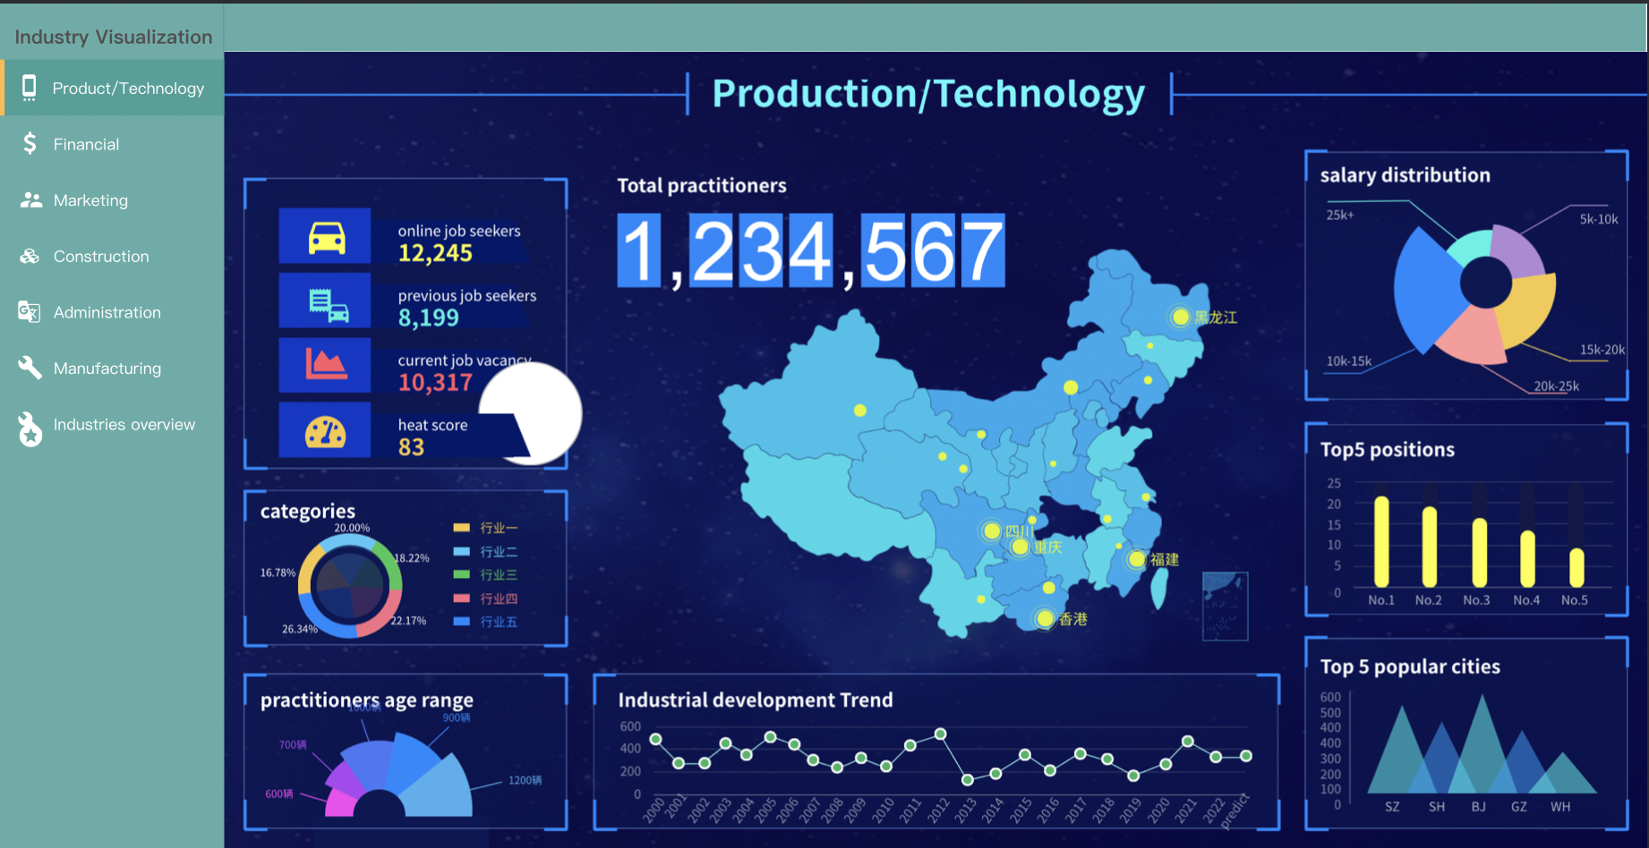
Front-end Design
Job Recommendation Interface
Sidebar: For navigation, the user selects the industry of interest
Multiple visualizations to display distribution and related information of industries
6

Slide 12
Data Sheet Format
1. Users comments data sheet
User Name | Email | Comments | Create time
Aria | 0xxxxxxxxxxxxx | I have trouble in getting the template… | 2022-05-30 12:05
2. User self-description data sheet
User Name | Description | Create time
Aria | Want to do product analysis and improvement, create new product…. | 2022-05-30 22:10
7

Slide 13
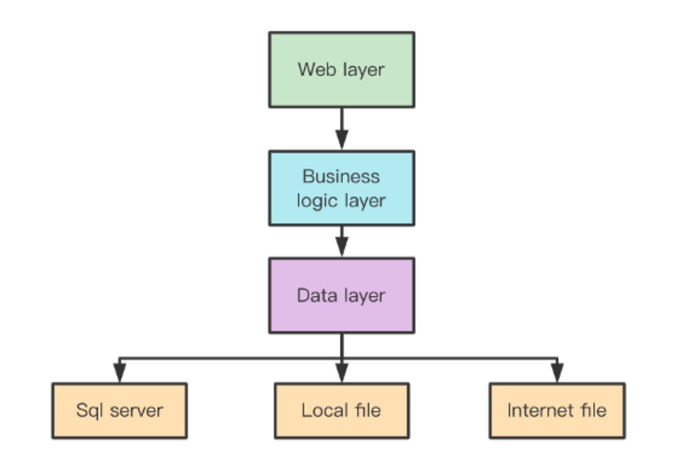
System Design — Back-end
13
Notes:
System implementation level, designing in business architecture and dividing the business of the entire application layer into Web layer, business logic layer, and data layer. The layers are interconnected, transmitted, and inseparable. At the same time, in the process of layering, the idea of ​​creating and using is clear. The distinction of levels reflects the idea of ​​"high cohesion and low coupling".
Web Layer
It mainly expresses WEB mode, where the logic layer is quite powerful and perfect, no matter how the Web layer is defined and changed, the logic layer can provide services perfectly. It mainly accepts the user’s request and returns the data, providing
the client with access to the application.
Business Logic Layer
It is mainly for the operation of specific problems, and it can also be understood as the operation of the data layer and the processing of data business logic. If the data layer is a building block, then the logic layer is the construction of these building blocks. It is the business logic layer and the part that reflects the core value of the system architecture. It is located in the middle of the data access layer and the presentation layer, and plays the role of linking the previous and the next in the data exchange. Since the layer is a weakly coupled structure, the dependencies between layers are downward, the bottom layer is "ignorant" to the upper layer, and changing the design of the upper layer has no effect on the bottom layer it calls. If the idea of interface-oriented design is followed in the hierarchical design, then this downward dependency should also be a weak dependency. Therefore, on the premise of not changing the interface definition, the ideal layered architecture should be a "drawer" architecture that supports extraction and replacement.
Data Layer
It is mainly the operation layer of non-original data (database or text file, etc.), rather than the original data, that is, the operation of the database, not the data, specifically for the business logic layer or presentation layer. Data services, which can access the database.

Slide 14
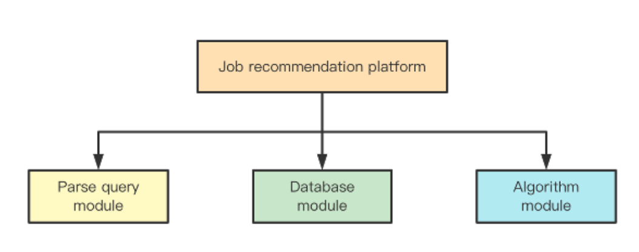
Back-end Design
Unit Module Design
14
Notes:
Our job recommendation platform consists of three main module
Parse query module is used to analyze the user’s input.
Database module are mainly responsible for interacting with database, calling database CRUD interface.
Algorithm module is used to recommend matching jobs for users.

Slide 15
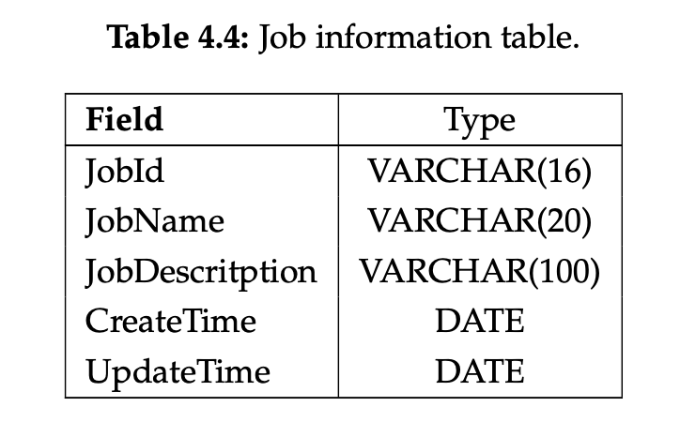
MongoDB
Database Design
15
Notes:
Our database will use MongoDB, MongoDB is a source-available cross-platform document- oriented database program. Classified as a NoSQL database program, MongoDB uses JSON-like documents with optional schemas. MongoDB is developed by MongoDB Inc. and licensed under the Server Side Public License. The table structure as follows, we also build hash index at JobId which help us retrive the related job information quickly.

Slide 16
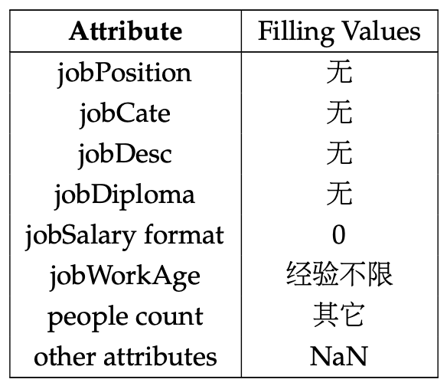
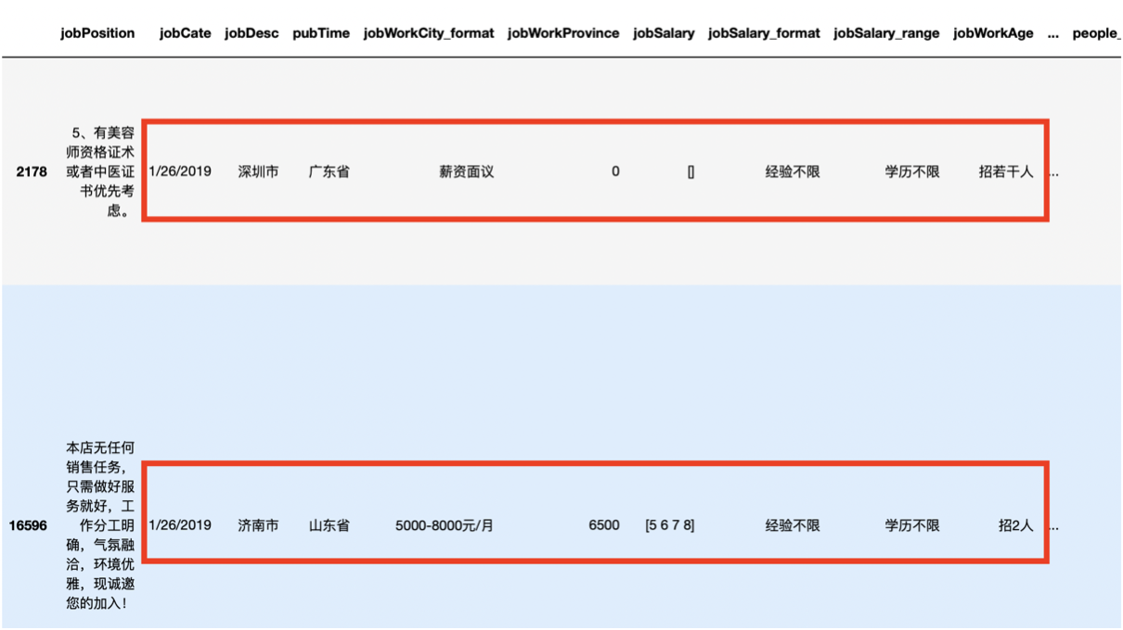
Data Cleansing
Missing Value Handling：
Incorrect Value Handling：
Adjust the order of these attribute values

Slide 17
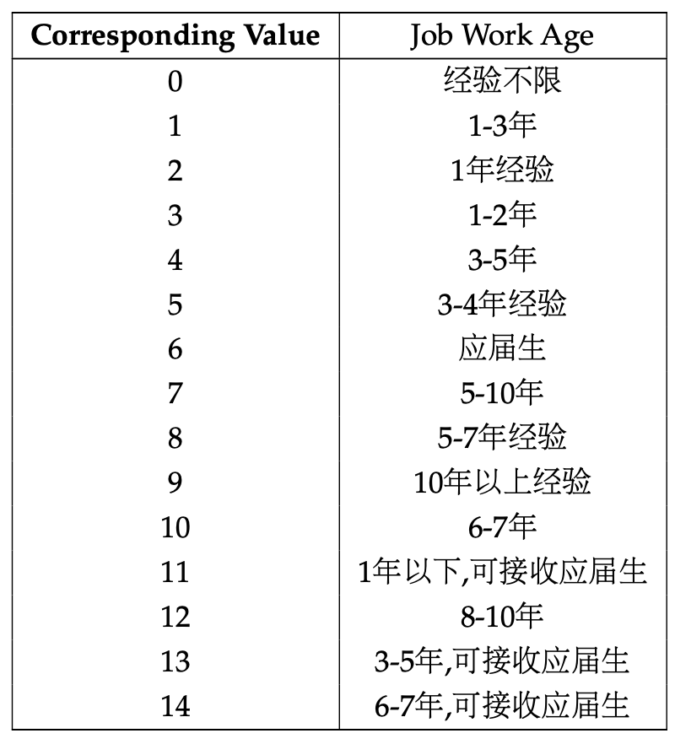
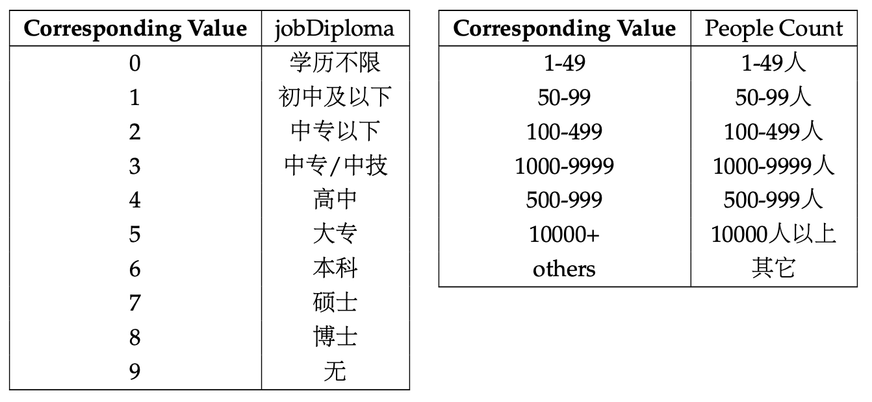
Data Cleansing
Attributes Normalization
Merge attribute values with the same or similar meanings and normalize them

Slide 18
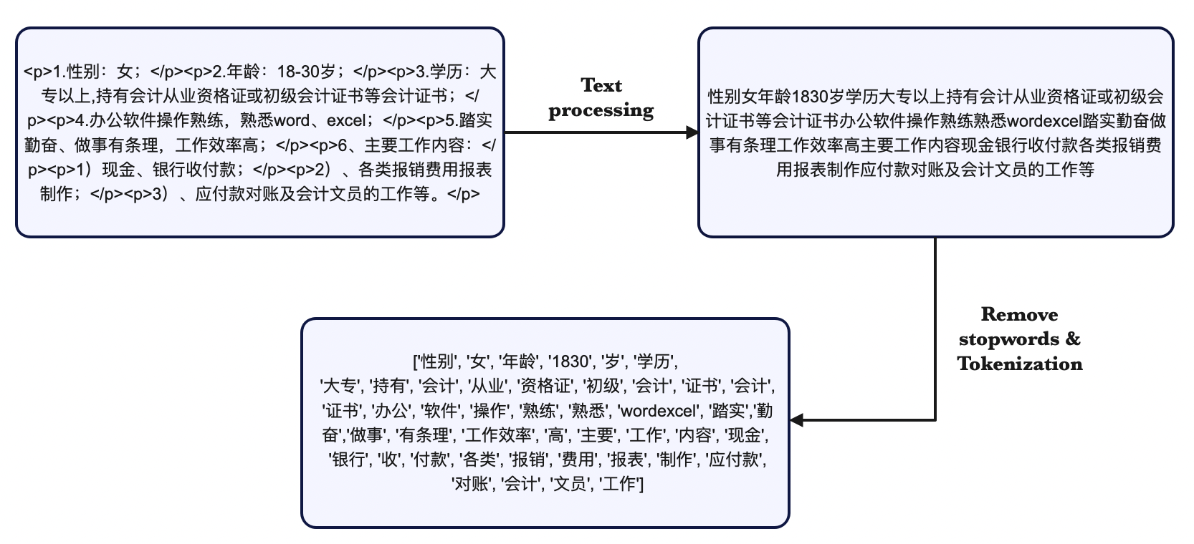
Data Cleansing
Text Preprocessing
Remove punctuation, URL, extra spaces, HTML tags, and title symbols and convert traditional Chinese characters into simplified Chinese characters with Regular Expressions

Slide 19
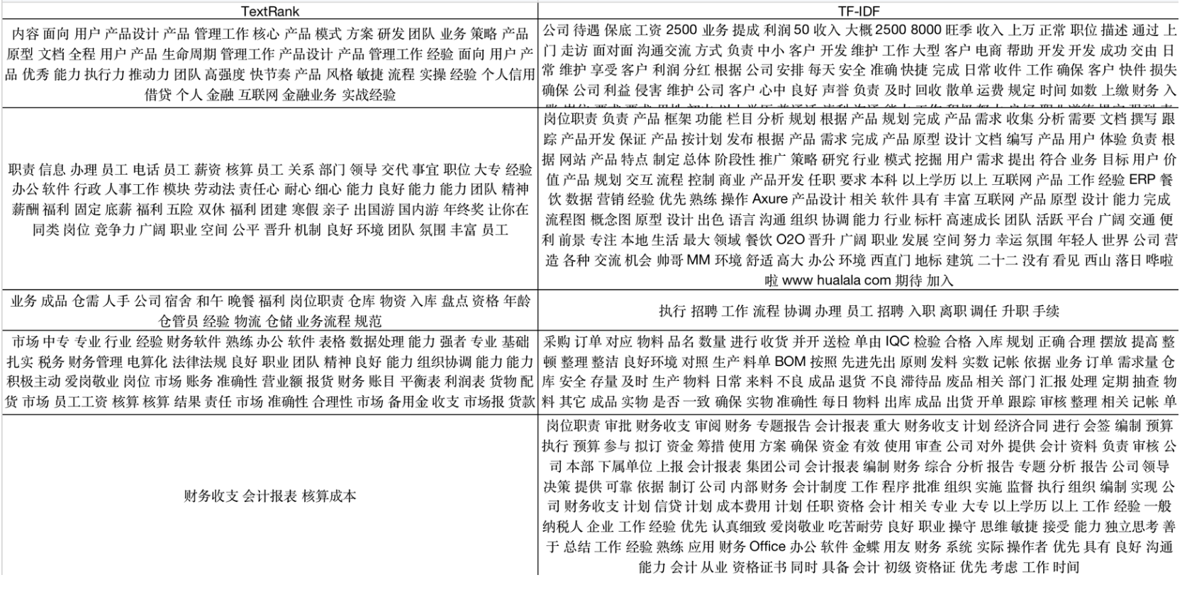
Feature Engineering
Job Description
Use TF-IDF and Textrank to extract features from job description

Slide 20
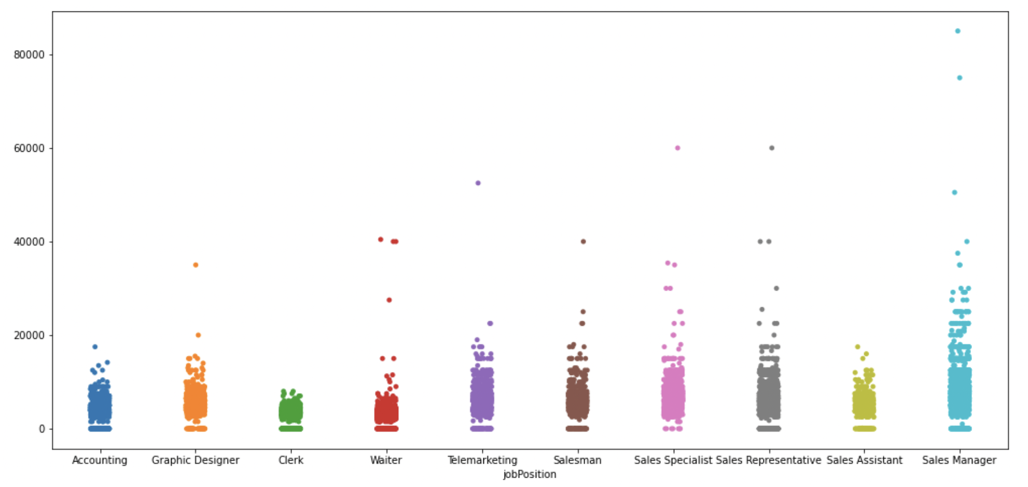
Feature Engineering
Job Salary

Slide 21
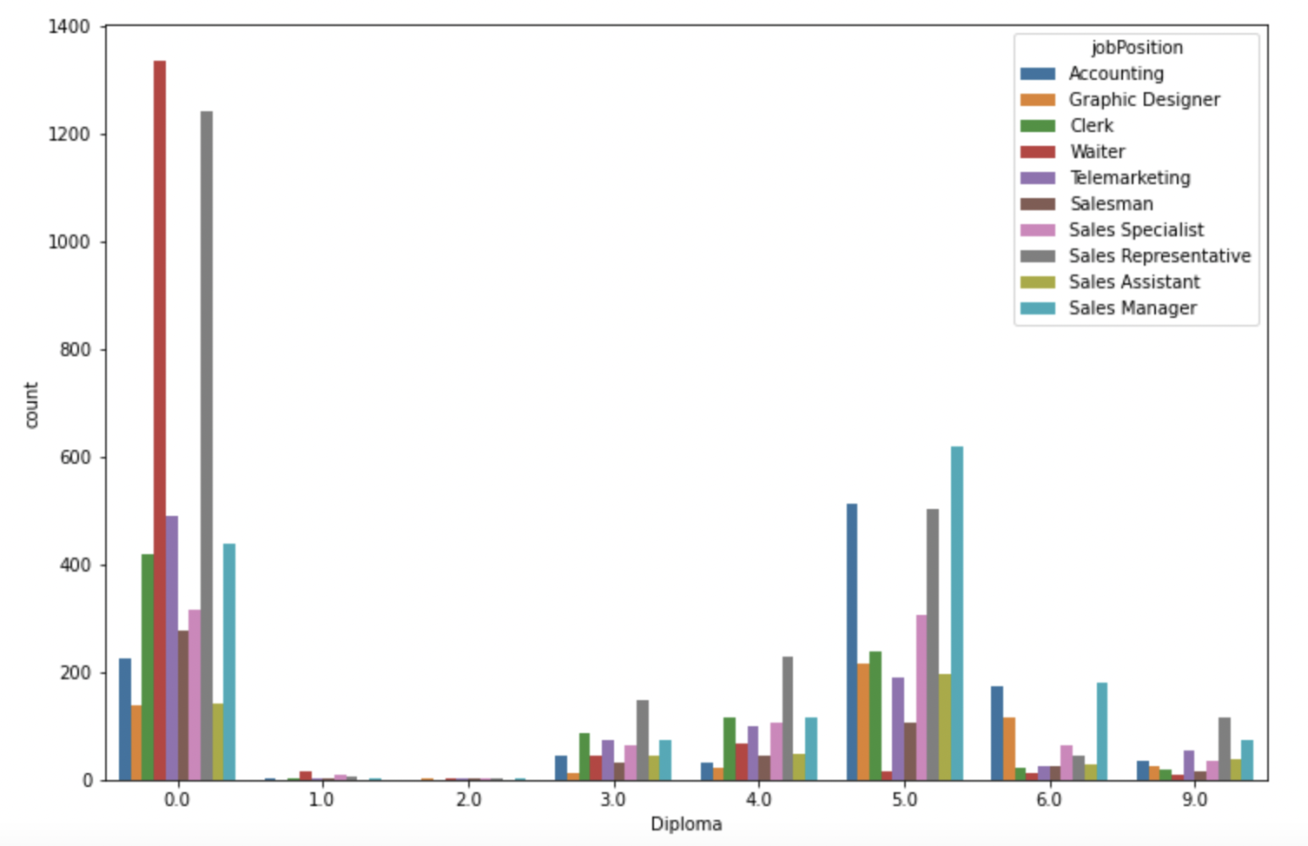
Feature Engineering
Diploma

Slide 22
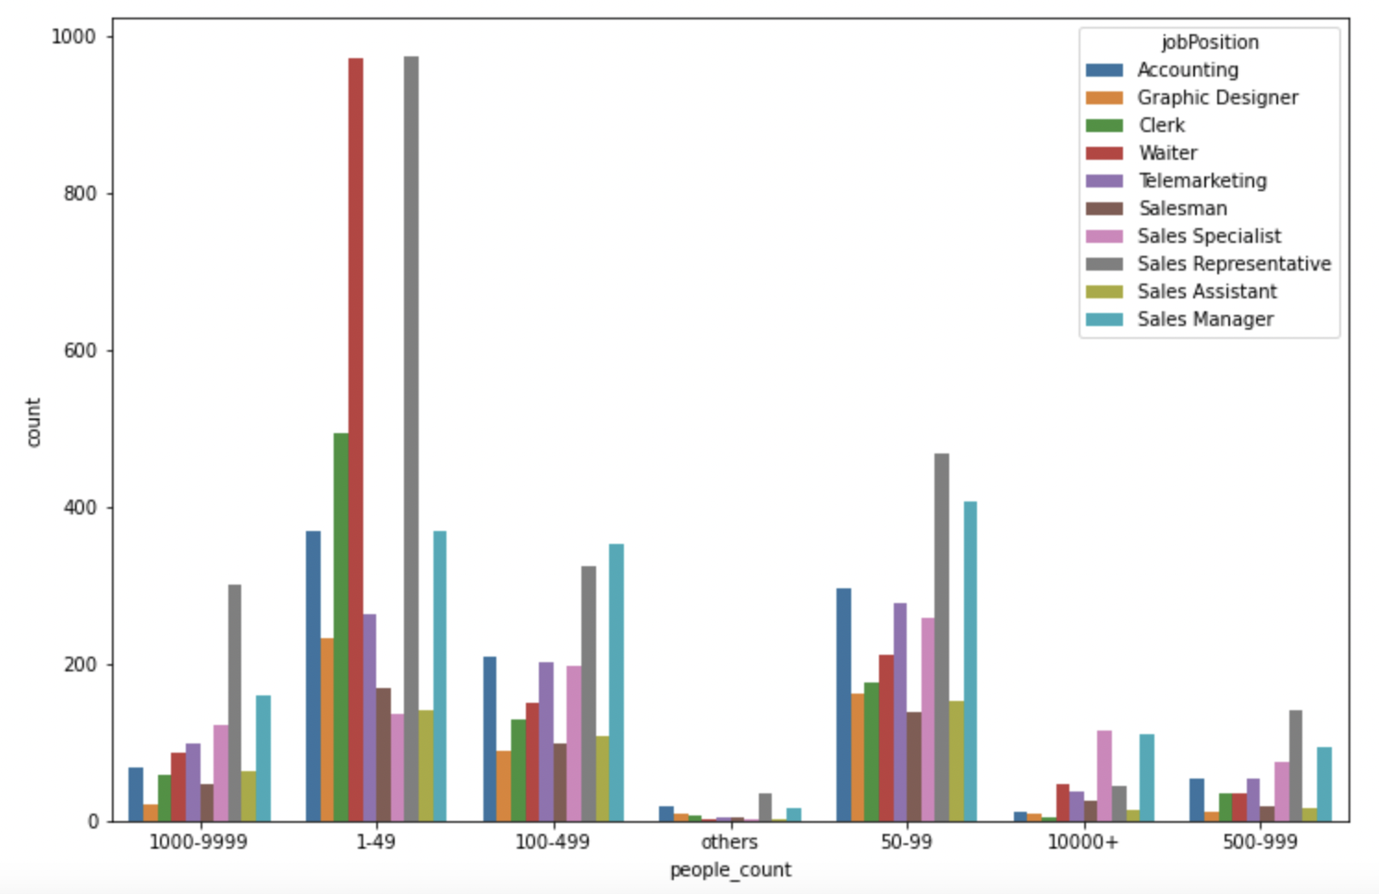
Feature Engineering
The Number of Employees

Slide 23
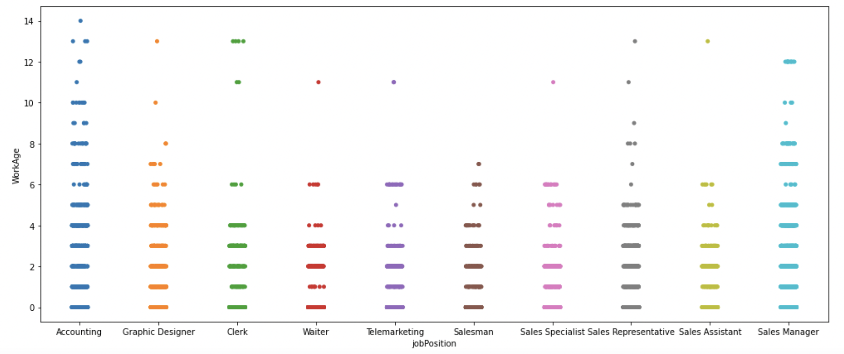
Feature Engineering
Work Age

Slide 24
Model Implementation
DistilBERT + GRU
DsitilBERT + BiGRU
DistilBERT + LSTM
DistilBERT + BiLSTM
DistilBERT + CNN
DistilBERT + Linear Layer
Code
24

Slide 25
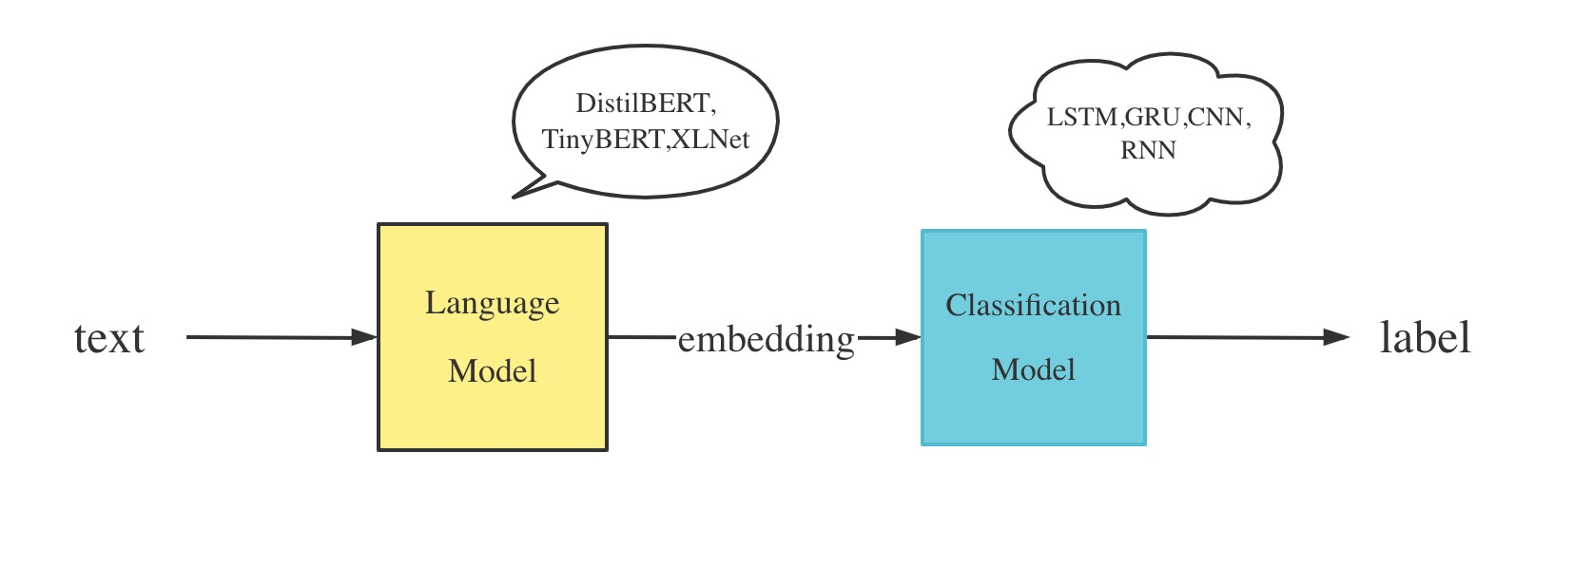
Model Implementation

Slide 26
Experiment
Results:
Text Classification
 | MCC | Accuracy | Precision | Recall | F1
DistilBert-FC | 0.56 | 0.57 | 0.57 | 0.57 | 0.55
DistilBert-CNN | 0.56 | 0.57 | 0.57 | 0.57 | 0.54
DistilBert-GRU | 0.56 | 0.57 | 0.54 | 0.57 | 0.55
DistilBert-Bi-GRU | 0.56 | 0.57 | 0.57 | 0.57 | 0.55
DistilBert-LSTM | 0.57 | 0.57 | 0.51 | 0.57 | 0.53
DistilBert-Bi-LSTM | 0.58 | 0.58 | 0.60 | 0.58 | 0.59
Notes:
Experiment analysis

Slide 27
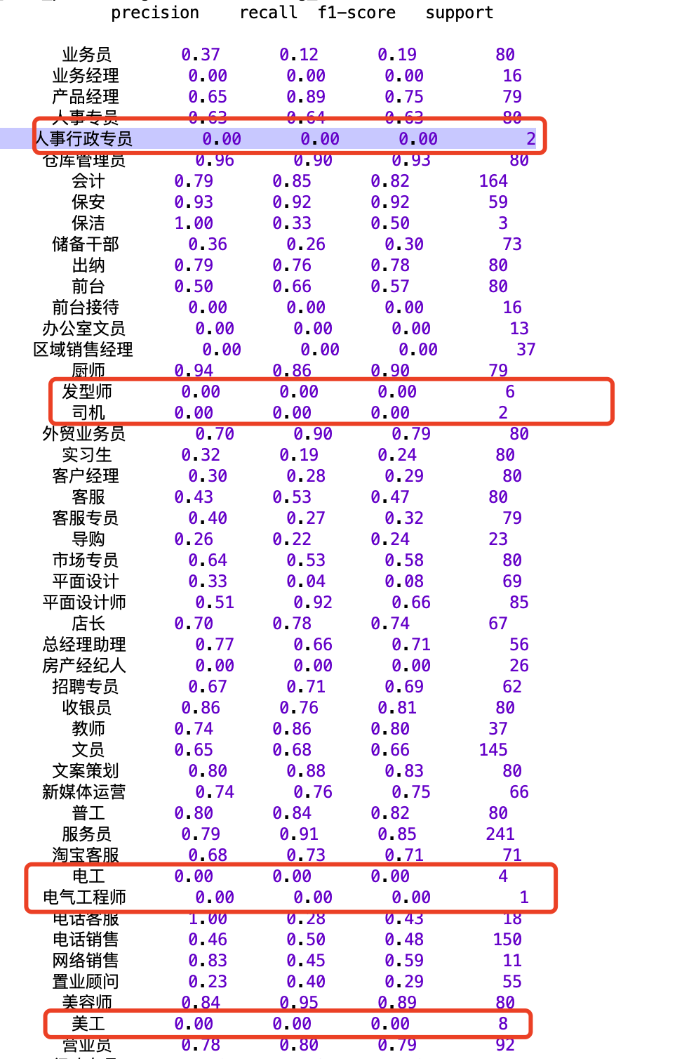
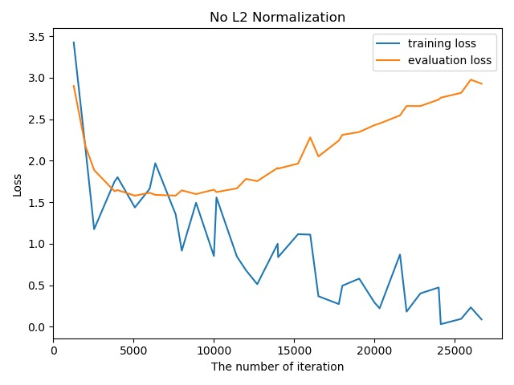
Data Distribution
Overfitting

Slide 28
Experiment Analysis
Overfitting:
It may be caused by complex model architecture and small scale of dataset.
Low accuracy:
There are too many noise data in job descrption.
There are too many kinds of job positions and some of them are very similar.
The amount of data varies for each job position.
Notes:
Experiment analysis

Slide 29
Expected Solutions
Solve overfitting
Enlarge dataset
Normalization
Dropout
Increase accuracy
Add class weight
Add other features
Reduce and merge job positions (computing similarity by description).
Notes:
Experiment analysis

Slide 30
Thanks！

